Slide 1
ECE501- Digital Image Processing
Content-Based Image Retrieval (CBIR)
Group 6
Dhriti Gandhi | AU2340030
Aneri Kabrawala | AU2340041
Renee Vora | AU2340059
Pushti Sonak | AU2340082

Slide 2
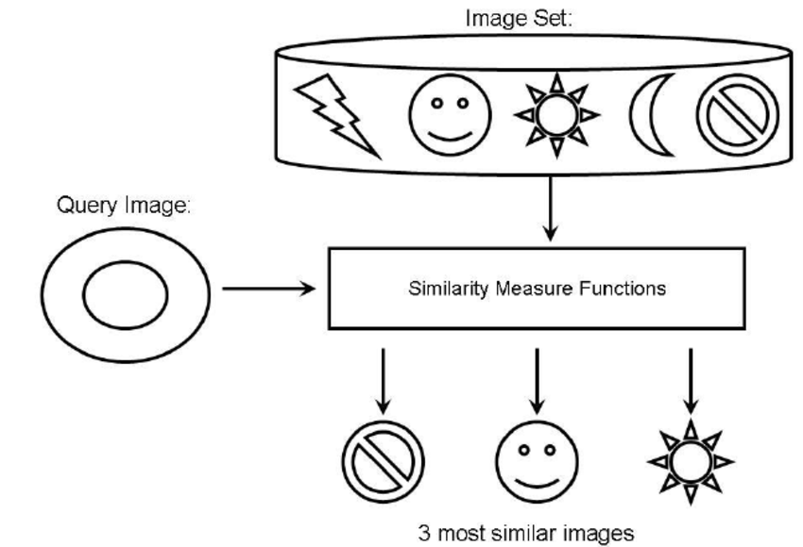
Introduction
Due to an exponential increase of image data across every domain, there is a need of systems that retrieve images based on the actual visual characteristics to achieve meaningful searches.
The features based on which our CBIR system retrieves images are:
colour
edge
texture
fusion of both colour and edge
By analyzing such features more accurate results can be obtained which on scaling have wide applications in medical imaging, security and surveillance and image search.
Source: Research Gate
[1]

Slide 3
Literature Review
Colour and edge descriptors have been used in classical CBIR systems that provide similarity results but poorly perform under lighting variations and scaling conditions.
Later works improved retrieval precision that implemented combined Fuzzy Colour and Texture Histograms (FCTH), which was robust to low-level features but limitedly performed on large/complex datasets.
An approach that fused wavelet coefficients and colour histograms enhanced precision and indexing time but had scalability problems.
In the quite recent work, HMMD-HDWT method, creates accurate feature vectors by combining Hadamard and wavelet transforms in the hue-min-max-difference (HMMD) colour space which is computationally heavy.
[5]
[3]
[4]
[2]

Slide 4
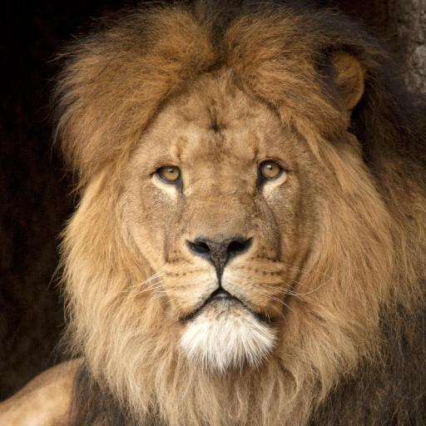
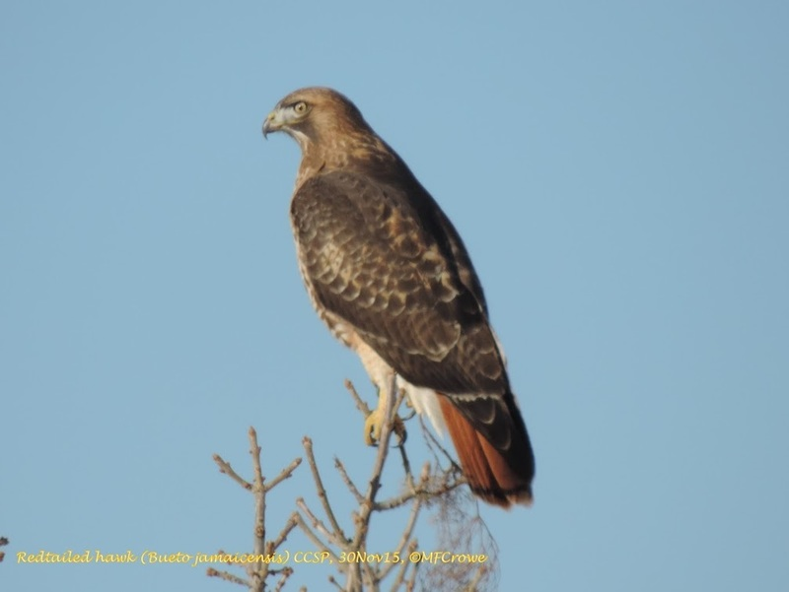
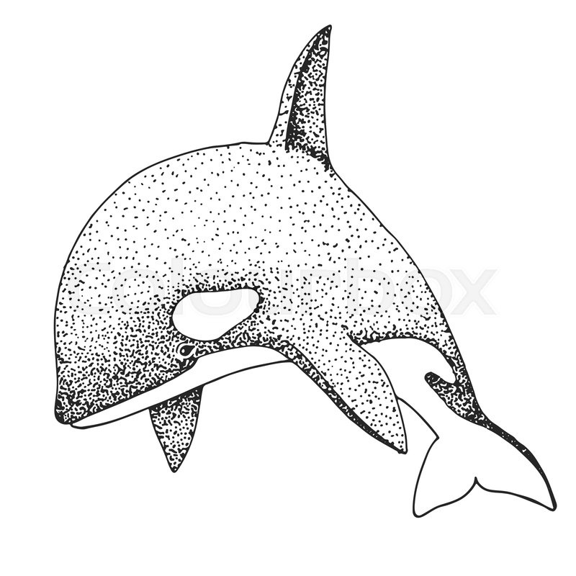
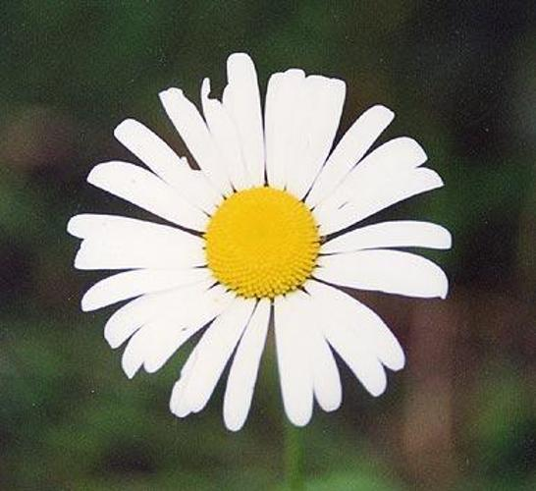
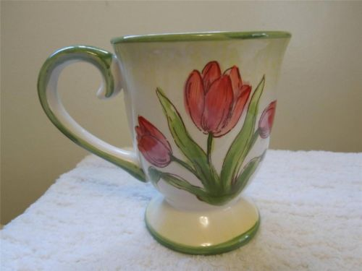
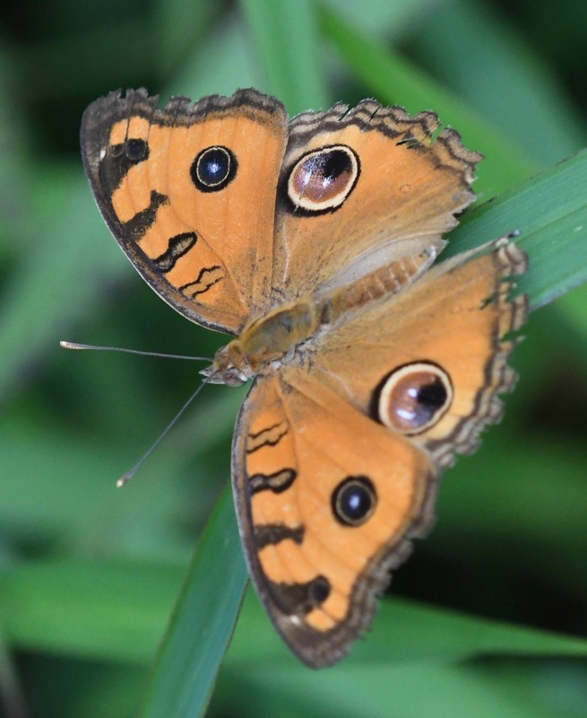
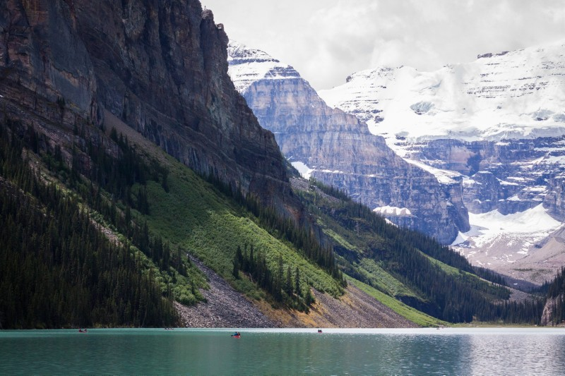
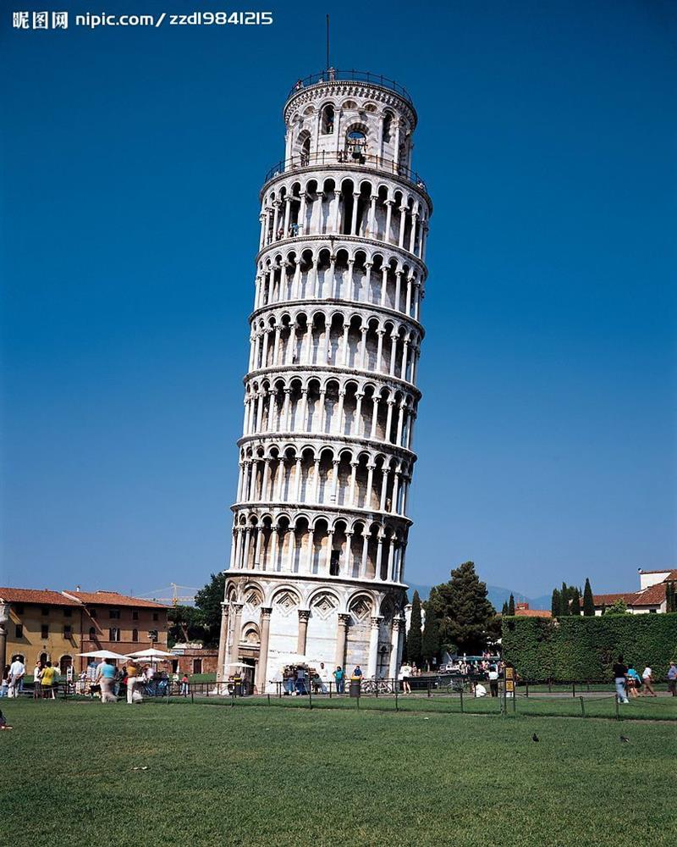
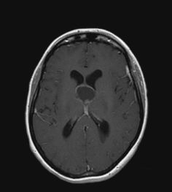
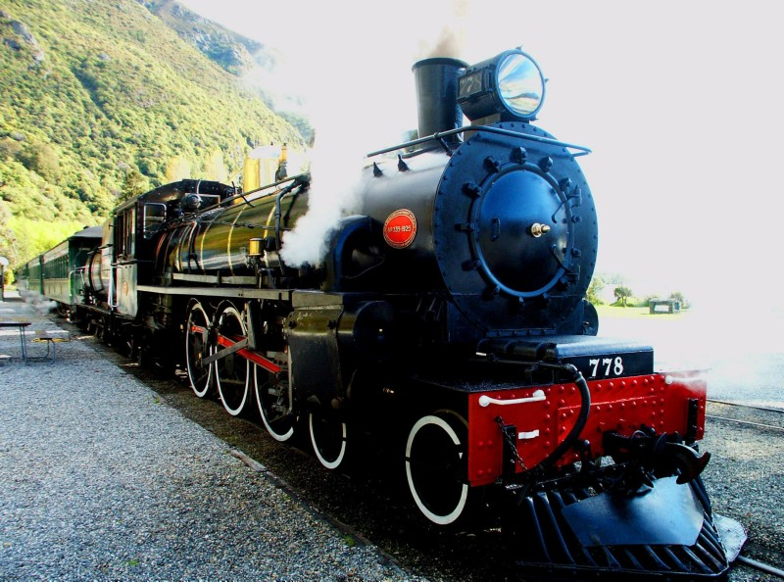
Dataset
Custom Dataset - 1000 images total - 100 images each category
Animals
Birds
Drawings
Flowers
Items
Insects
Landscapes
Monuments
MRI
Transport

Slide 5
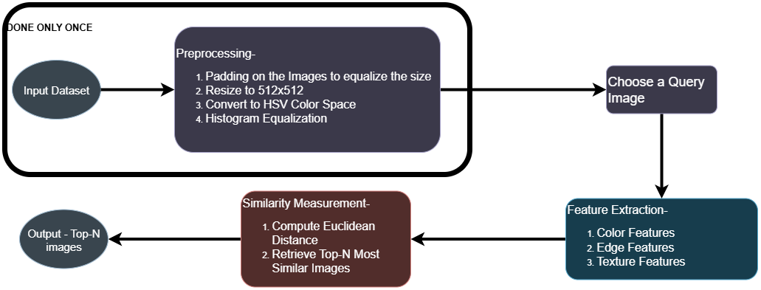
Methodology
The following flowchart shows the method we have been using till now. Further changes are to be done in the coming weeks.

Slide 6
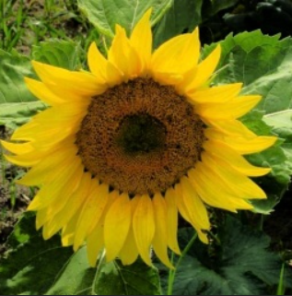
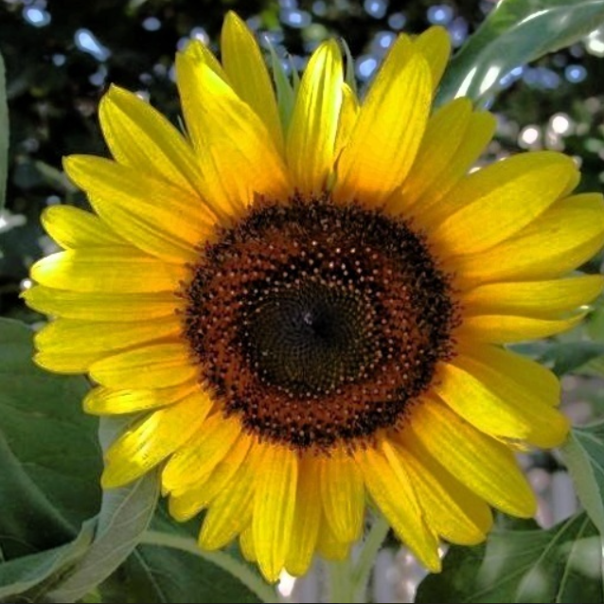
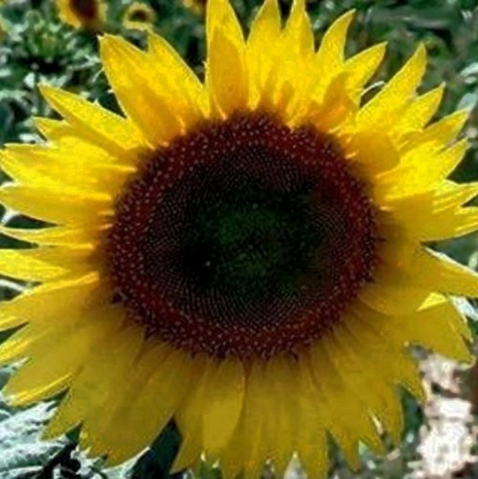
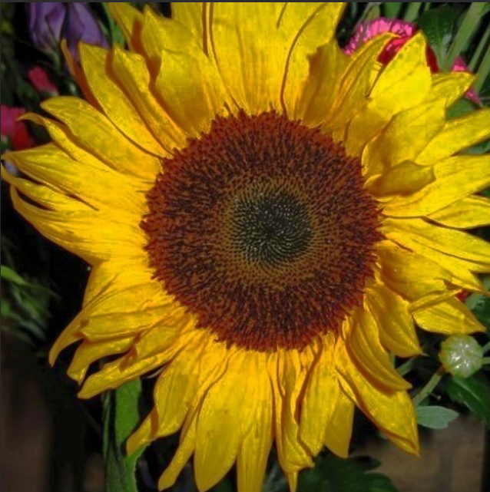
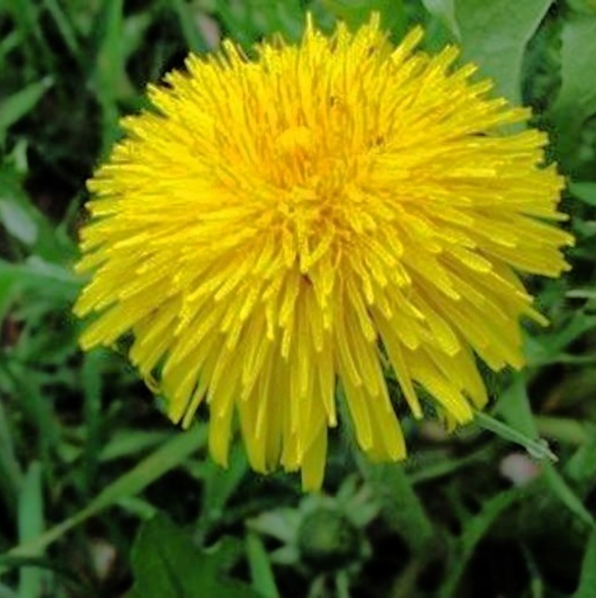
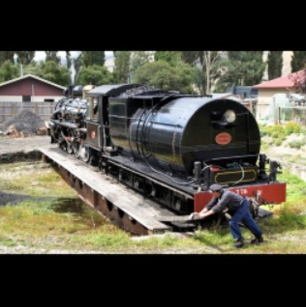
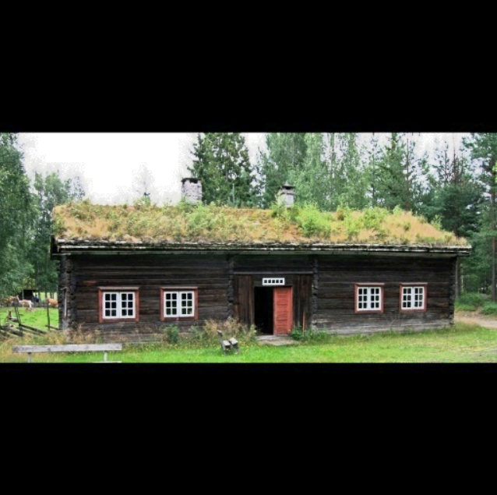
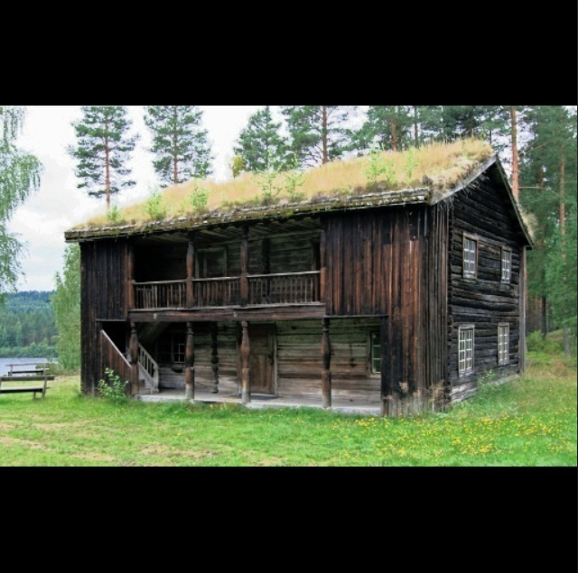
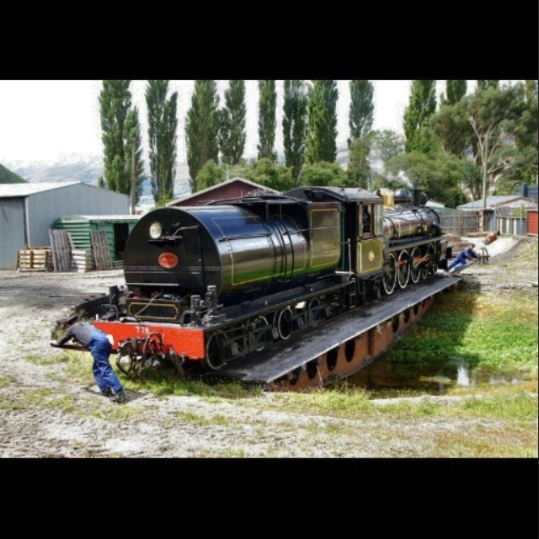
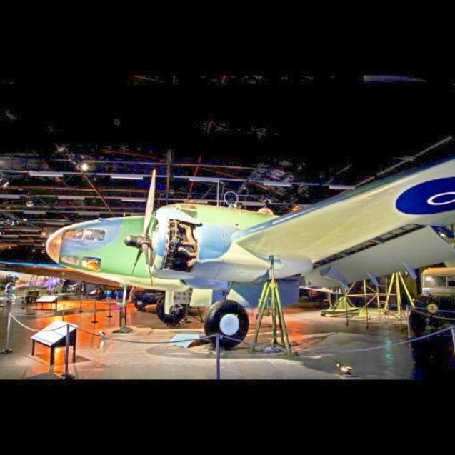
Results (Color-feature Extraction)
Query
Rank 1
Rank 2
Rank 3
Rank 4

Slide 7
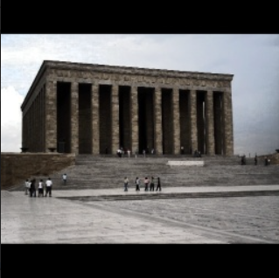
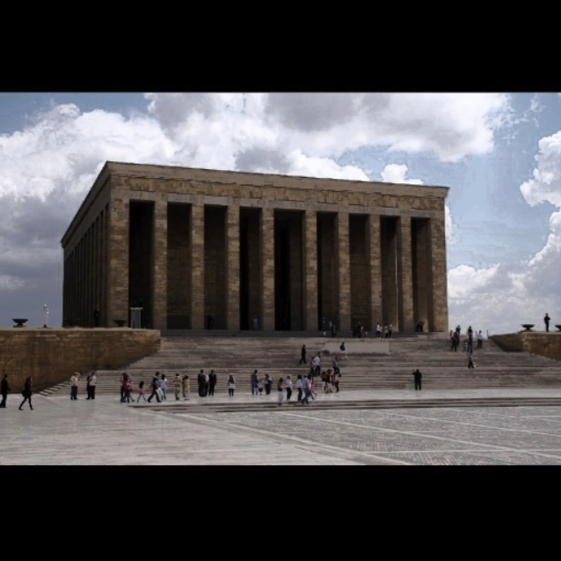
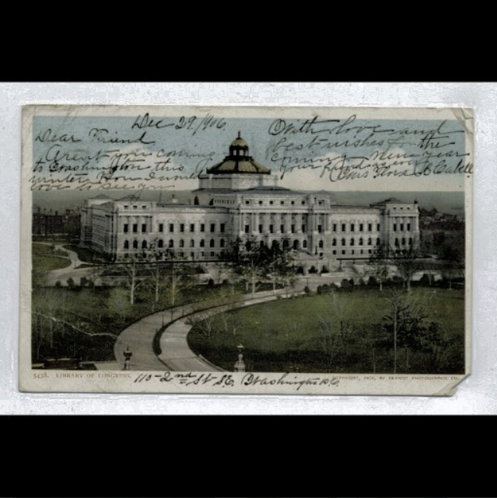
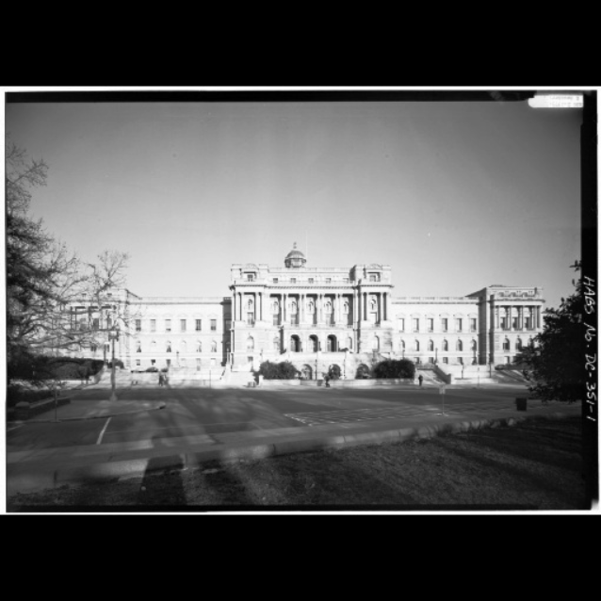
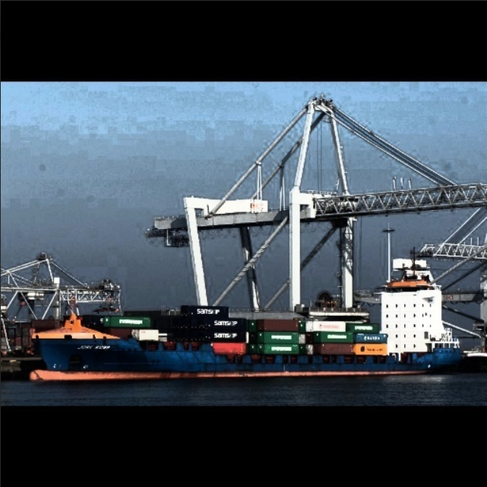
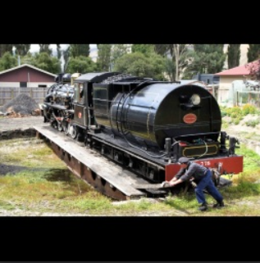
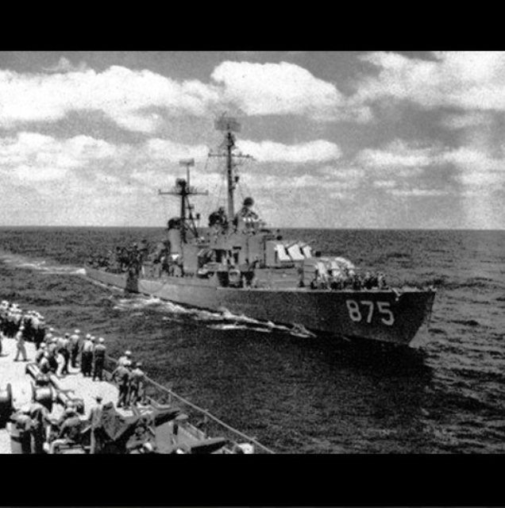
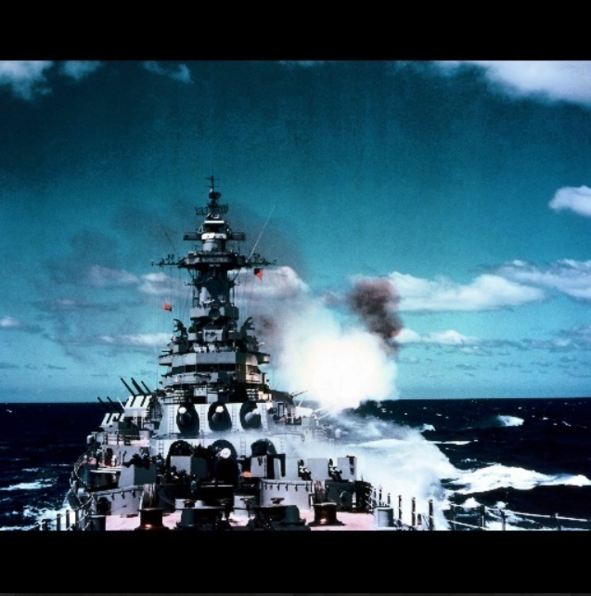
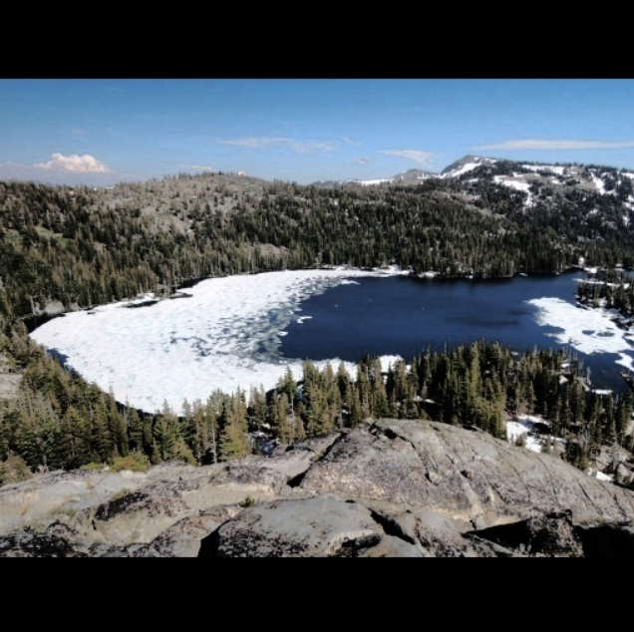
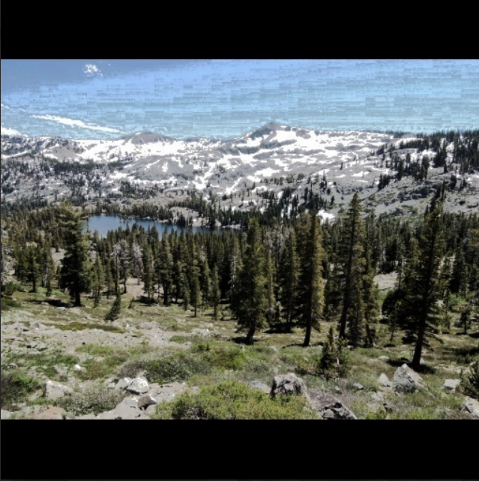
Results (Edge-feature Extraction)
Query
Rank 1
Rank 2
Rank 3
Rank 4

Slide 8
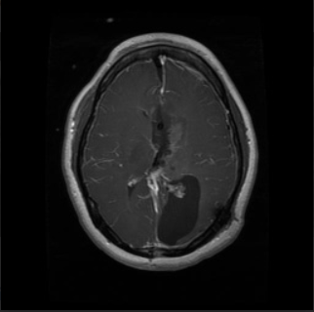
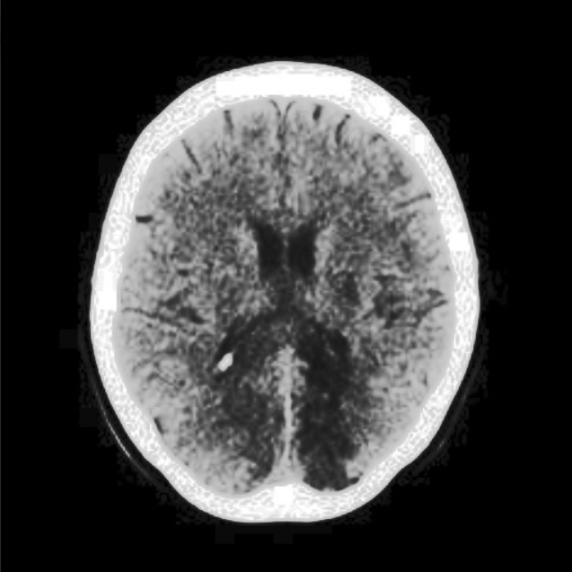
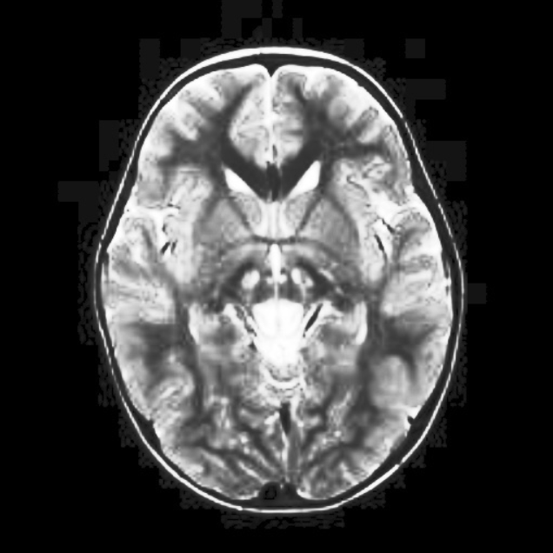
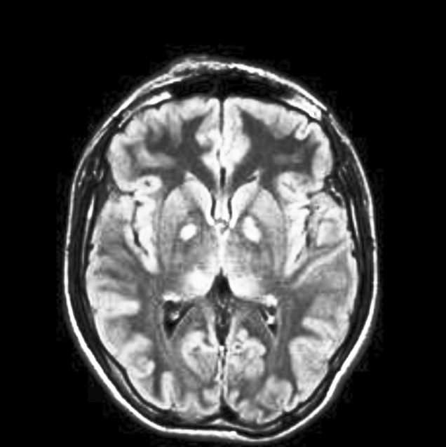
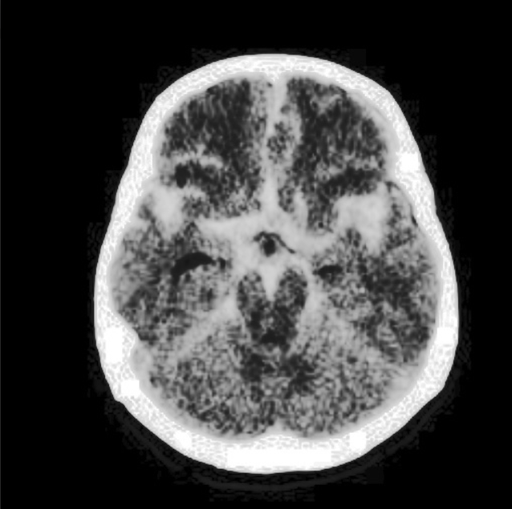
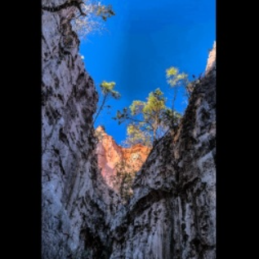
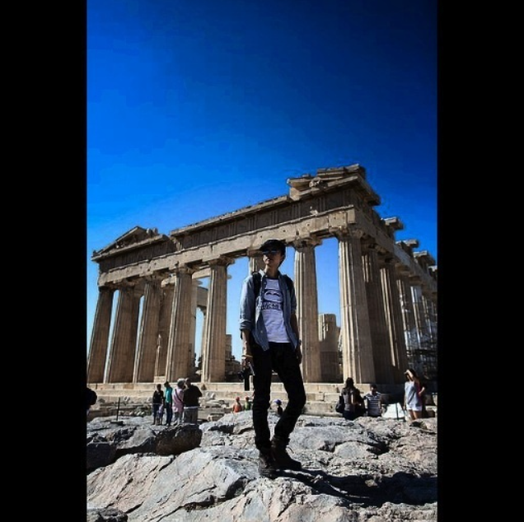
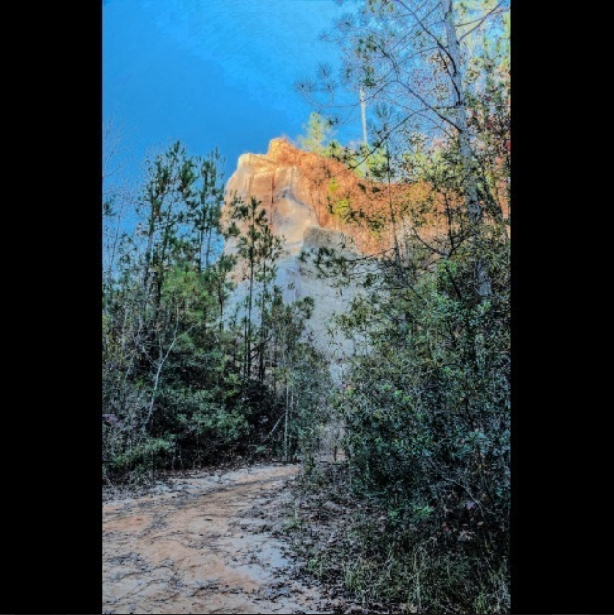
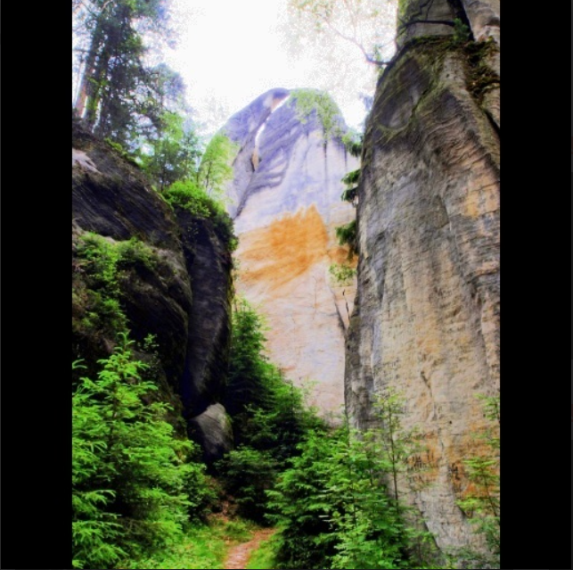
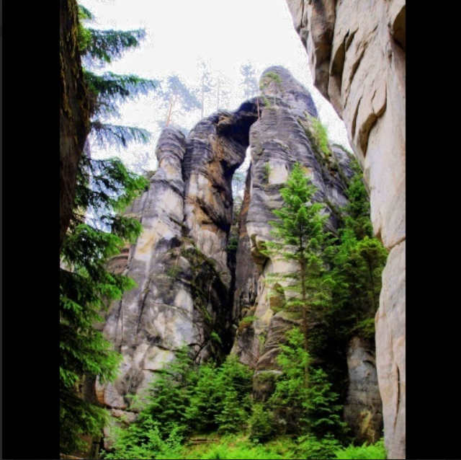
Results (Color-Edge Fusion)
Query
Rank 1
Rank 2
Rank 3
Rank 4

Slide 9
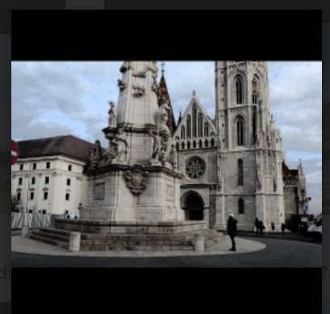
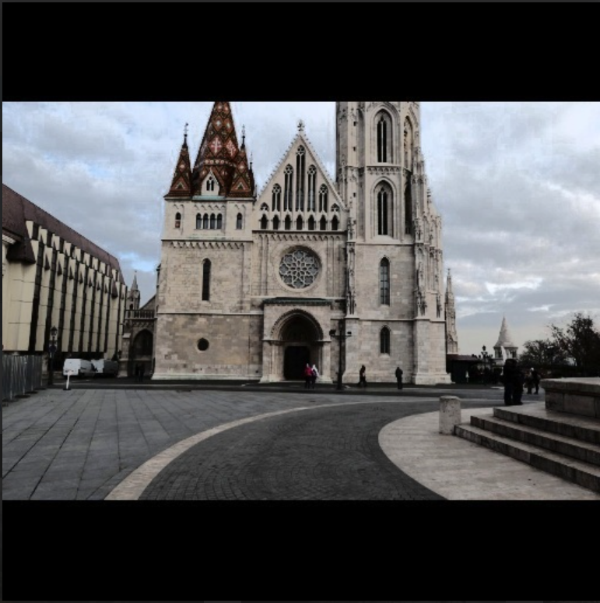
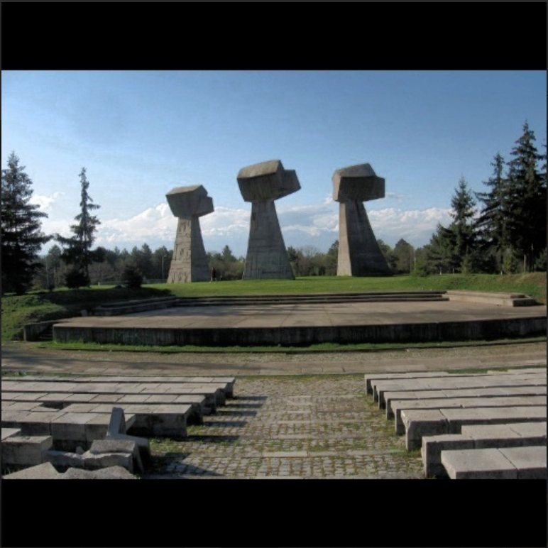
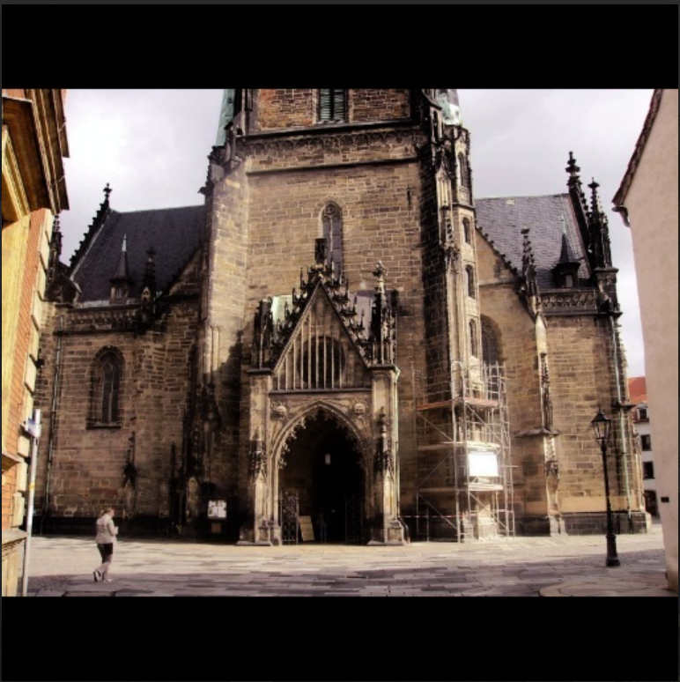
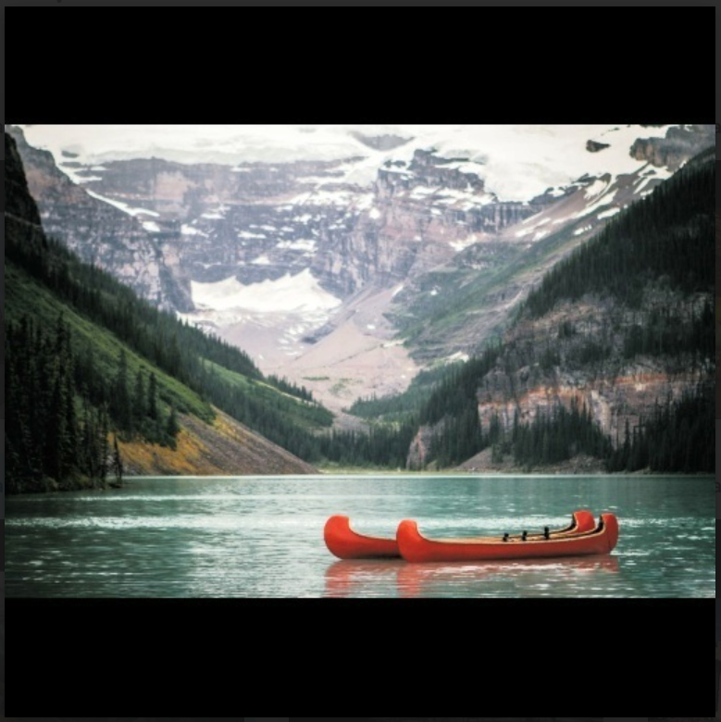
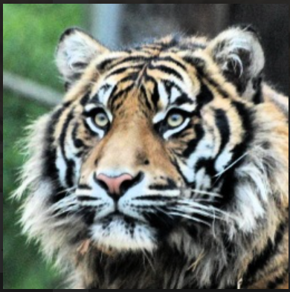
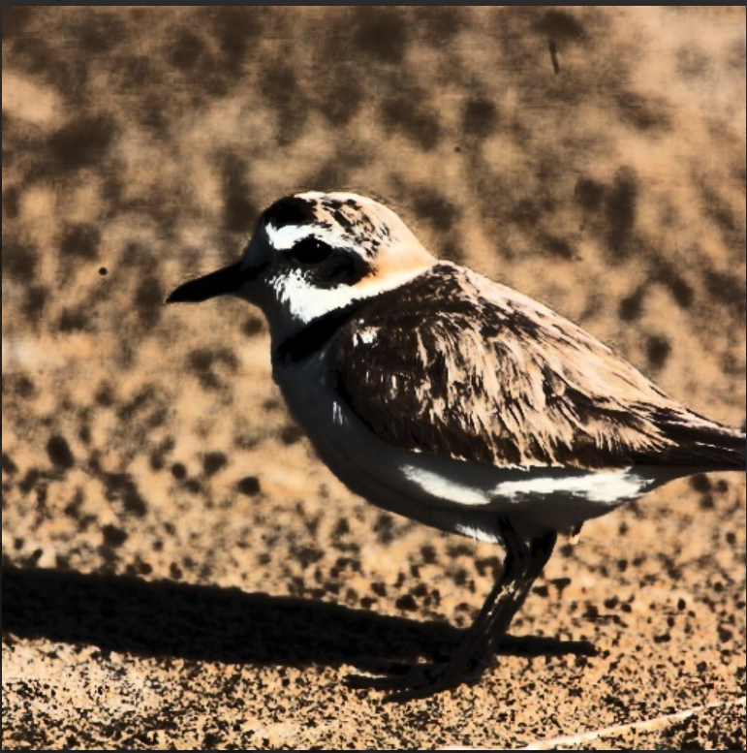
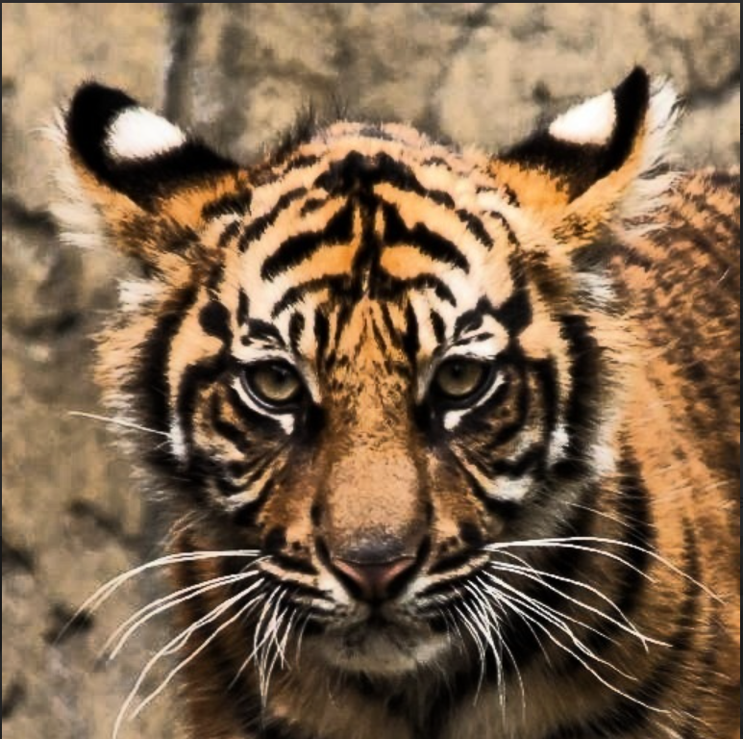


Results (Texture-feature Extraction)
Query
Rank 1
Rank 2
Rank 3
Rank 4

Slide 10
Conclusions
The preprocessing work was a success along with histogram equalization. But,the additional padding done to make the images of same size, has shifted the histogram to left.
Successfully implemented individual feature-based retrieval methods (Color (HSV), Edge (Sobel), and Texture (LBP) ) and even Color-Edge Fusion
Color-edge fusion gave better results consistently in almost all types of dataset than individual methods.
Other retrieval methods (feature expansion) are yet to be implemented and experimented along with dataset centralization

Slide 11
Next set of work
Implement, test, and validate the performance of all three feature fusion methods, including the weighted feature fusion approach.
Evaluate and integrate ways to bring more accuracy to the achieved results by experimenting with different available methods/algorithms.
Centralize our dataset to a particular domain, determine and incorporate additional image properties pertaining to the domain to improve retrieval accuracy.
Performance analysis of our approach and its comparison with existing models.

Slide 12
References
[1] C. Knoblock, “An example of Content-Based Image Retrieval,” ResearchGate, [Online image]. Available: https://www.researchgate.net/profile/Craig-Knoblock/publication/221607221/figure/fig3/AS:305582780239874@1449868020143/An-example-of-Content-Based-Image-Retrieval.png. [Accessed: Oct. 12, 2025].
[2] H. Farsi and Sajad Mohamadzadeh, “Colour and texture feature‐based image retrieval by using Hadamard matrix in discrete wavelet transform,” IET Image Processing, vol. 7, no. 3, pp. 212–218, Apr. 2013, doi: https://doi.org/10.1049/iet-ipr.2012.0203.
[3] K. Haridas and A. Selvadossthanamani, “Efficient Content Based Image Retrieval System in Visual Words, Color and Edge Directive Descriptors and Fuzzy Color and Texture Histogram,” International Journal of Innovative Research in Computer and Communication Engineering (An ISO, vol. 3297, 2007, Accessed: Oct. 12, 2025. [Online]. Available: https://www.rroij.com/open-access/efficient-content-based-image-retrievalsystem-in-visual-words-color-and-edgedirective-descriptors-and-fuzzy-color-andtexture-histogram.pdf
[4] M. Singha and K. Hemachandran, “Content Based Image Retrieval using Color and Texture,” Signal & Image Processing : An International Journal, vol. 3, no. 1, pp. 39–57, Feb. 2012, doi: 10.5121/SIPIJ.2012.3104. Available: https://aircconline.com/sipij/V3N1/3112sipij04.pdf
[5] R. Kumar and N. Murthy M S, “Enhanced Content Based Image Retrieval Using Integrated Color and Texture Features,” International Journal on Science and Technology, vol. 16, no. 1, Jan. 2025, doi: https://doi.org/10.71097/ijsat.v16.i1.1418.

Slide 13
Dataset - References
[6] Aayush Bajaj. (2020). CBIR_dataset [Data set]. Kaggle. https://www.kaggle.com/datasets/theaayushbajaj/cbir-dataset
[7] Mathurin Ache, “GPR1200 Dataset,” 2021. [Online]. Available: https://www.kaggle.com/datasets/mathurinache/gpr1200-dataset/data. [Accessed: Oct. 12, 2025]
[8] Msoud Nickparvar. (2021). Brain Tumor MRI Dataset [Data set]. Kaggle. https://doi.org/10.34740/KAGGLE/DSV/2645886
[9] Visual Geometry Group, “Oxford 17 Flowers Dataset,” 2008. [Online]. Available: https://www.robots.ox.ac.uk/~vgg/data/flowers/17/index.html. [Accessed: Oct. 12, 2025]

